Slide 1
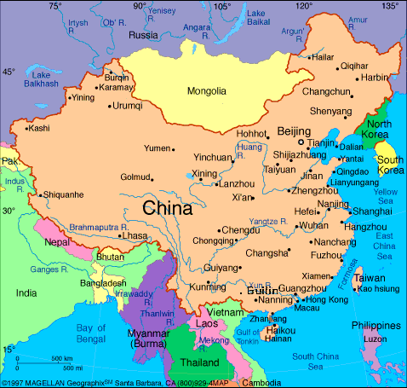
China is a country in Asia. It is
located in East Asia.

Slide 2
Geographic features isolated China.
Mountains and deserts separated China from the rest of Asia.
The Himalayas separate India from China.
The Gobi desert lies in the north.

Slide 3
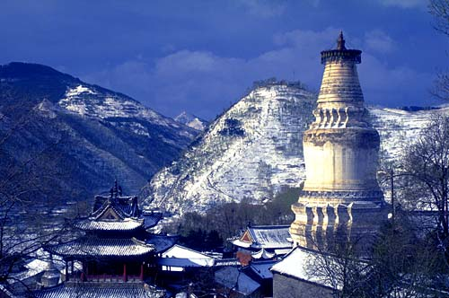
Mountains isolated China. Mountains
separated China from parts of Asia.

Slide 4
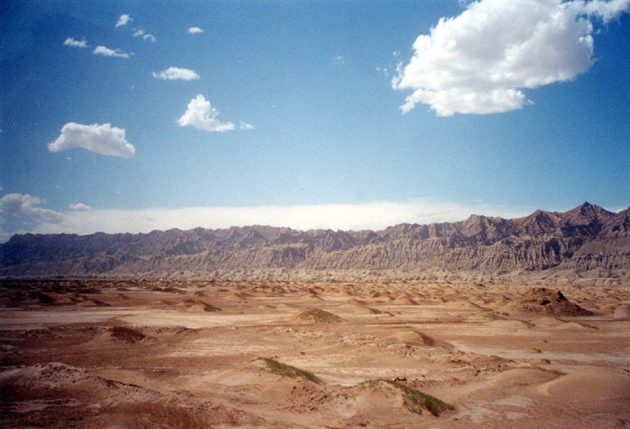
The Gobi desert stretches for
miles along the border of Mongolia
and China.

Slide 5
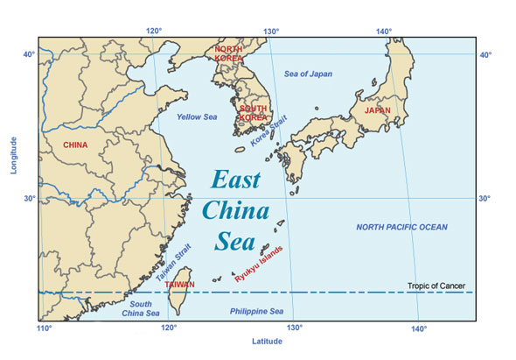
Seas protected China’s east.

Slide 6
China’s isolation helped it develop its own unique culture.
However, Chinese ideas and practices influenced other cultures.
Many Asian cultures were influenced by China’s culture. Cultural diffusion occurred.

Slide 7
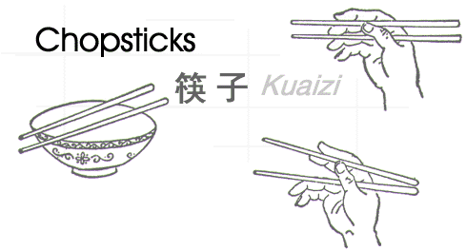
Chinese ideas and practices like the
use of chopsticks influenced other
Asian cultures.

Slide 8
China has many important rivers.
The Huang He or Yellow river floods and is called “China’s Sorrow” because its unpredictable flooding has caused destruction of both homes and crops, resulting in famine (starvation).
The Yangtze river is China’s longest and most important river. It is used for transportation.

Slide 9
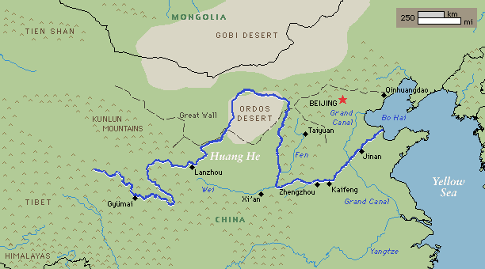
The Huang He river is rich in silt. The
silt is yellow in color.

Slide 10
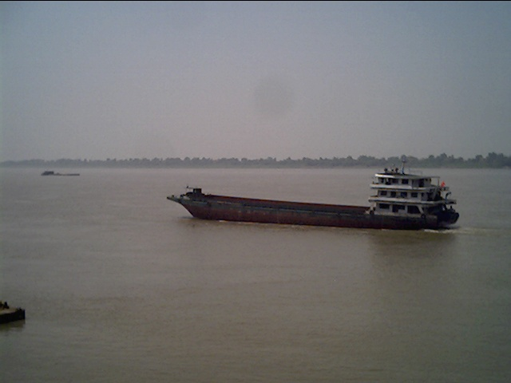
The Yangtze river is the longest river
in Asia and the third longest river in the
world.

Slide 11
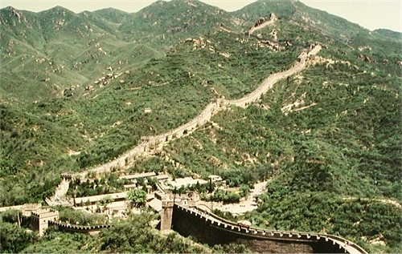
The Great Wall of China was built to
protect China from invaders.

Slide 12
Ancient Chinese rulers built the Great Wall of China to protect China from nomadic invasions from the HUNS.
Many Chinese died building the vast wall.
This defensive wall was built on the northern border of China.

Slide 13
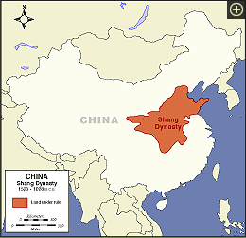
The first Chinese dynasty was the
Shang dynasty. A dynasty is a ruling family

Slide 14
The Shang dynasty emerged
around 1760 B.C.
It built the first Chinese cities.
A system of writing developed called pictographs.

